Slide 1
Mcdonalds Menu
Data Analysis
By:Sanjay Tomlinons

Slide 2
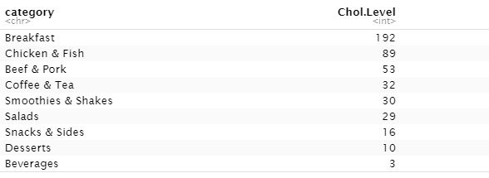
Question 1- What category will give you the most Cholesterol at Mcdonalds if you order from it?
The Mcdonalds menu category with the highest cholesterol level was the breakfast menu
The table on the right shows a table describing our findings by cholesterol level.

Slide 3
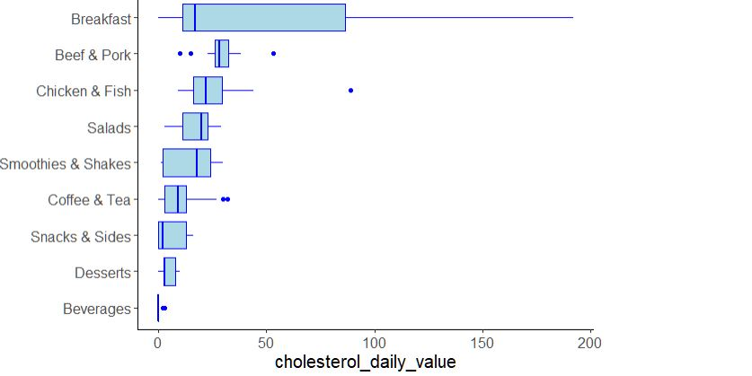

Slide 4
Question 2- Is there a difference between ordering egg whites instead of a whole egg?
Their is a difference between ordering egg white vs a whole. Mainly in the amount of protein , Caloric Value, and the Cholesterol Value.
Caloric Value - There is a difference of about 120 calories between egg whites and whole eggs. With whole eggs coming out on top for caloric value when compared to one cups worth of each.
Protein- There is not to huge of a difference between the amount of protein between both egg whites and whole eggs. With only a small difference in protein values with egg whites on top.
Cholesterol Value- There is a huge difference in the cholesterol value between egg whites and whole eggs. With a whopping 200 value difference between the two. Whole eggs take the lead for cholesterol value mainly due to the egg yolk.

Slide 5
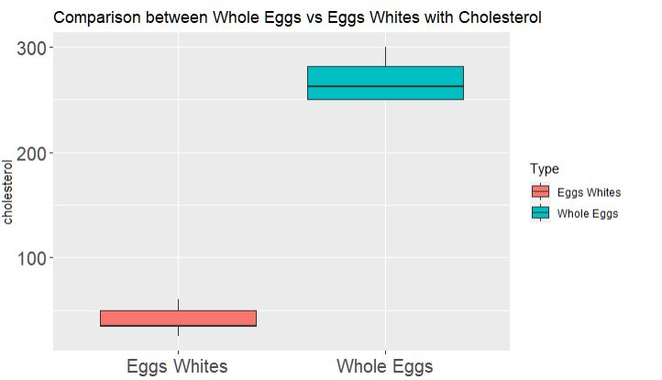
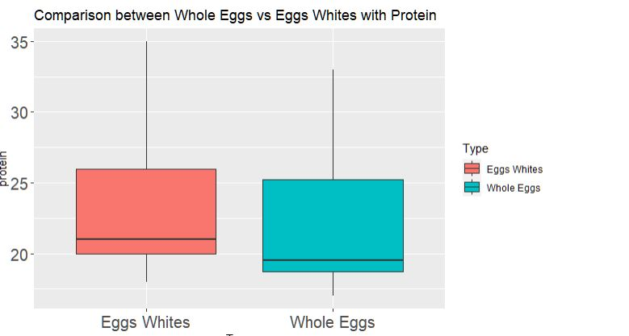
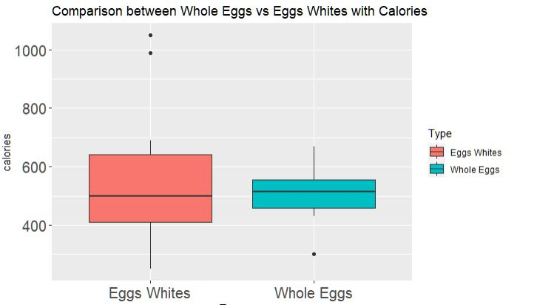

Slide 6
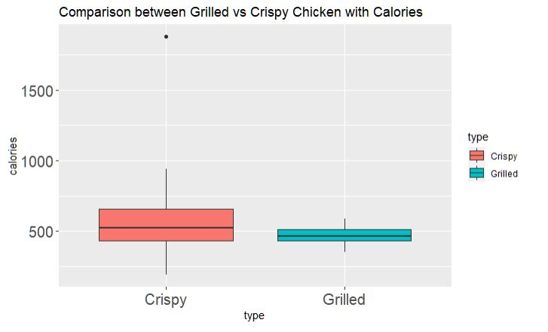
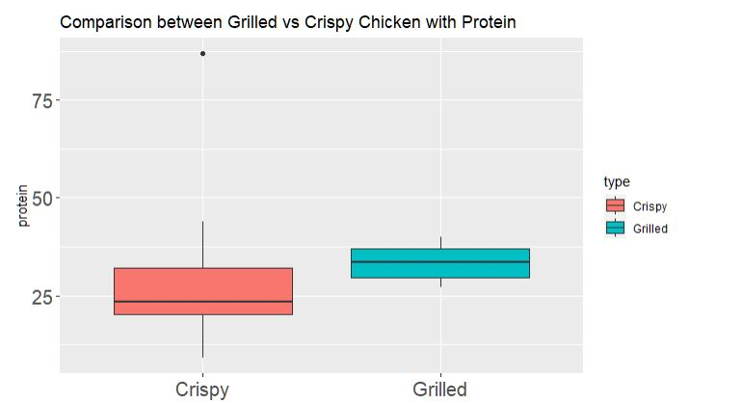

Slide 7
Question 3- Does having the chicken being grilled really add to the nutritional value of a chicken sandwich?
When comparing the caloric count and the amount of protein between the crisp and grilled chicken sandwich there was a difference.
Caloric count- There was difference of about 200 clories between crispy and grilled chicken sandwich
Protein- There was a differ of around 10-12 values of protein between the grilled and crispy sandwich

